Slide 1
Insertion Sort

Slide 2
Insertion Sort

Slide 3
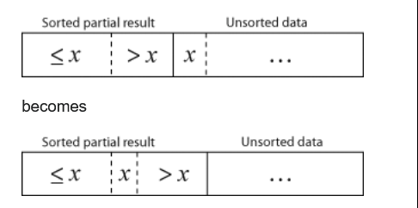
Insertion Sort

Slide 4
Insertion Sort

Slide 5
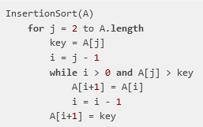
Insertion Sort

